Slide 1
Gear shaper processing method and trouble improvement
Kyushu Musashi Seimitsu Co.
Production Engineering Section, Engineering Department
willow field
2019-11-22

Slide 2
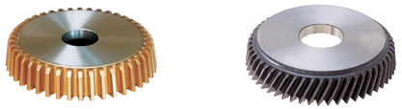
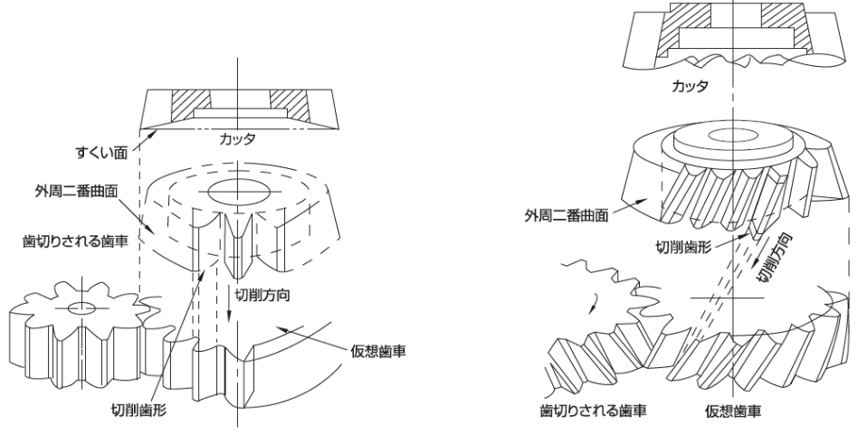
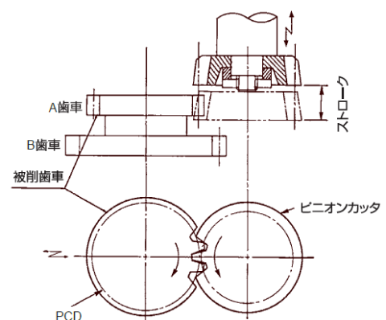
pinion cutter
Principle of tooth cutting of pinion cutter
The cutter reciprocates in the direction of the gear tooth trace to create a virtual gear, and then forcibly applies a relative motion between the cutter and the gear material to ensure correct meshing.
The part that interferes with the movement of the teeth of the virtual gear is shaved off from the gear material, and the tooth profile of the gear is created.
Features of pinion cutter tooth cutting
1. The gear cutting of the internal gear can be done.
2. The gear cutting of the stepped gear can be done.
3 They can cut special gears (jointed teeth, missing teeth).
Cutter
Rake Face
Cutter
A Gear
OD 2nd Curved Surface
Stroke
OD 2nd Curved Surface
B Gear
Gear to be machined
Machined Tooth profile
Cutting Direction
Work Gear
Cutting Direction
Pinion Cutter
Virtual / Hypothetical Gear
Machined Tooth profile
Gear to be machined
Virtual / Hypothetical Gear
Tooth cutting by spur pinion cutter
Tooth cutting by helical pinion cutter
Tooth cutting by pinion cutter

Slide 3
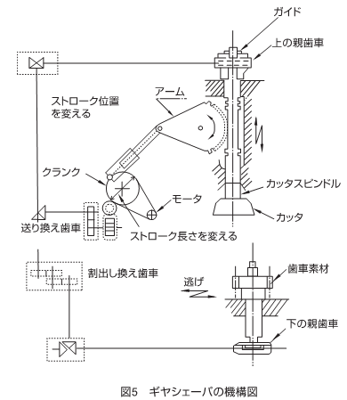
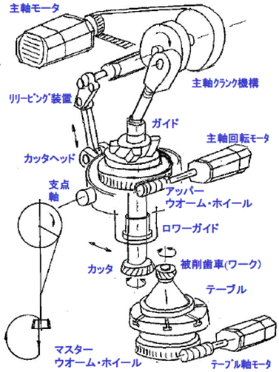
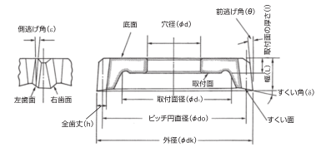
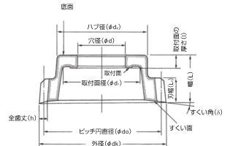
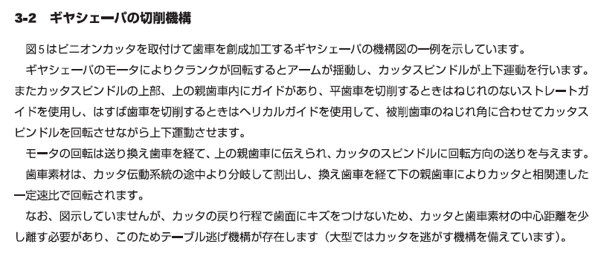
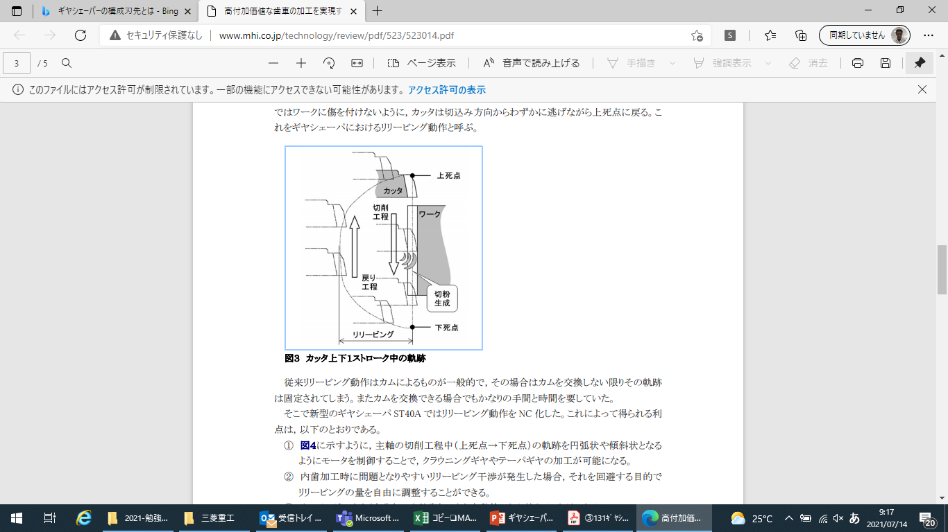
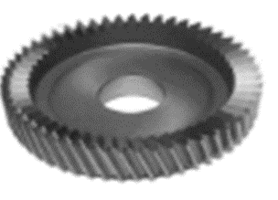
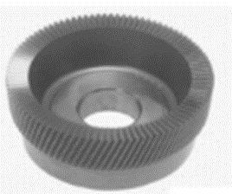
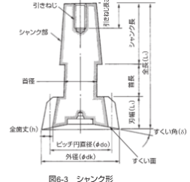
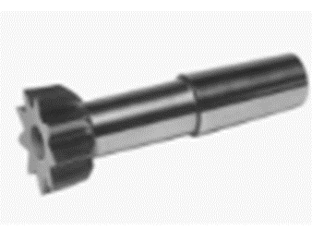
Gear shaper processing method
Cutting mechanism of gear shaper
desk style | bell-shaped (e.g. curve)
Spindle motor
Spindle crank device
Relieving device
Guide
Spindle Rotating motor
Cutter Bed
Fulcrum Shaft
Upper worm wheel
disk-shaped
If the cutter becomes thin after cutting, the tightening nut may interfere with the cutter.
bell-shaped (e.g. curve)
Even if the cutter is thinner, the fastening nut does not pop out and does not interfere More expensive than disk
Lower Guide
Cutter
Work Gear
Table
Table
shank shaped
Master Worm Wheel
Table Spindle Motor
Reciprocating gear-shaped cutter in the tooth thread direction
shank shaped
For comparatively small diameter internal teeth The blade has a low life expectancy. Short, low stiffness expensive for the number of blades
When the crank rotates, the arm oscillates and the cutter spindle performs vertical movement. When cutting spur gears, the straight guide without torsion is used (helical guide in the case of helical gears) and the cutter spindle is rotated while moving up and down. In addition, in order not to scratch the tooth surface in the return process of the cutter, it is necessary to separate the center distance of the cutter and the gear material a little, and the table escape mechanism exists.
Synchronous rotation of cutter and workpiece
2) Reciprocating motion of cutter
(3) Release at the time of cutter return (releasing)
4) Cutter's cut
5) Position of cutter and workpiece, stroke width
⑥Others Cutter, workpiece clamping and changing

Slide 4
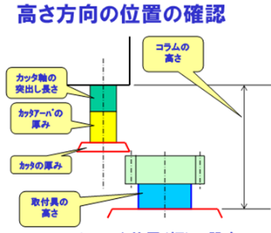
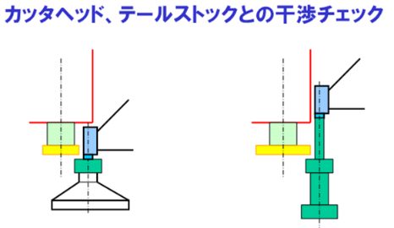
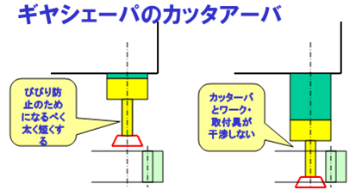

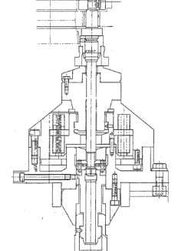
Setting of machining jigs and tools
Position confirmation at Height Direction
Thickness setting of cutter arbor
Main spindle thrust length
Column height
Workpiece mounting height
Types of cutters
Design with the above in mind.
Interference check of Cutter Bed & Tailstock
Column Height
Front thrust out length of cutter axis
Pay attention to the timing of the up and down movement of the tailstock.
Cutter arbour thickness
Cutter thickness
Setting the stroke position (width)
Column height should be high for versatility ⇒ Rigidity will be low
The cutter arbor should be as low as possible.
Longer and more chattering
Mounting Tool Height
For small workpiece diameter
Lower the workpiece and the tailstock.
Keep it under a column.
When the workpiece is long
Increase the cutter diameter so that the tailstock does not interfere with the column
Take into account the decrease in diameter at the reg of the cutter
Gear Shaper Cutter Arbor
Design of Gear Shaper Mounting Tool
Design Procedure
1・Selection of fixture model
(1) Shaft, gear, spur, helical
(2) Clamp position
2 Selection of cutters
Disc type, bell type, shank type
Number of teeth (diameter) Lead (helical gear)
Design Points
(1) The work position is as high as possible (minimum spindle protrusion).
Cutter (considering thinning by REG)
(3) Interference check of cutter head and tail stock
4) Interference check of sub-loader and deburring device
Cutta Arbor as much as possible.
Make it thicker and shorter
To prevent chattering as much as possible make it Thick & Short
The cutter diameter is not designed to be thinner than the spindle.
Consider the reg cost of the cutter
No fouling of cutter bar with work mounting tool
When the workpiece holder is higher than the workpiece, pay attention to the interference when the cutter moves.
When the cutter arbor is thin ⇒ Machining accuracy is reduced
Processing conditions cannot be increased.
Chattering of tooth surfaces
Tool life reduction
If you do REG, the spindle will be lowered because the cutter will be thinner.

Slide 5
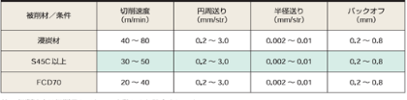
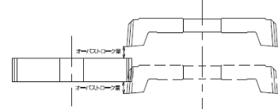
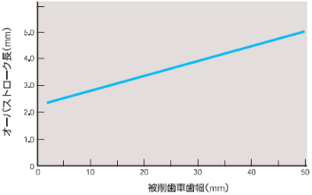
Setting of cutting conditions
To be determined by workpiece material, hardness and cutter coating
The number of cuts is determined by the required accuracy and ease of use.
Cutting speed
Workpiece material classification | material properties | hardness | rough work m/min | finishing touches m/min
carburized steel | SCr420H | 150-200 | 36-46 | 54-69
carbon steel | S45C | 210-280 | 28-35 | 42-53
carbon steel | SCM435 | 270-320 | 22-30 | 33-45
cast iron | FC250 | -220 | 32-40 | 48-60
Clearance Finish 0.2 to 0.4 mm
Middle 0.3～1.0mm
Ara The rest of the above
Cutting conditions for each work material
Module/Precision | JIS/IS06 |  |  |  | JIS 7-8 |  |  | JIS-9
MODULE 1
1-2
2-3
3-4
4-5
5-6
Number of cuts | one | two | three | four | one | two | three | one | two | three
Note 1: Cutting speed is set according to cutting length and number of strokes.
Note 2: When the cutting width exceeds 25 mm, the cutting speed is reduced by about 10%.
Reference.
Cutting speed (m/min)=stroke length (mm)×stroke number (str/min)×π)÷1000
Cutting speed
Vm・min-1
(TiN coating)
Precautions for processing
In gear shaping, runout at the time of installation of the cutter and gear to be machined should be kept within 5μm because it affects the step of the cut.
2. The stroke length during machining is the tooth width of the gear to be machined plus the upper and lower overstroke lengths. The overstroke length varies depending on the tooth width of the gear to be machined.
circumferential feed rate
Expressed as the feed length on the pitch circumference per stroke
During rough machining | Frotary=π×mn/a・COSβ
 | Number of strokes per pitch a: | 2 to 4 | Mn 2.5 or less
 |  | 4 to 8 | Mn 2.5 or more
During finish machining | Frot = 0.2 to 0.3 mm/str | Required accuracy Jis ～7 grade
 | 0.4 to 1.0 mm/str | Required accuracy Jis 8 class～
Max. chip cross section
In case of 20mm tooth width, over stroke width is more than 3.3mm.
Max. chip thickness
Max. chip thickness (mm)
Max. chip cross-sectional area
Even if the circumferential feed is increased, the maximum chip thickness and cross-sectional area remain almost constant, so the cutting force can be suppressed. |  | 1, Chips are broken up and tool life is extended.
 |  | 2. machining conditions can be increased and cycle time can be shortened
Radial feed 0.02mm/str
Relationship between Tooth Width and Overstroke Length of Machined Gears
3. In gear shaping, one tooth of the pinion cutter processes one groove of the gear to be machined, so special attention must be paid to tooth chipping and abnormal wear.

Slide 6
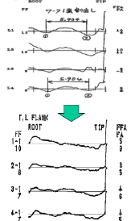
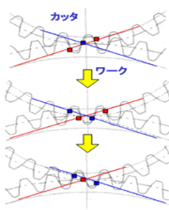
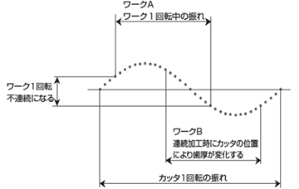
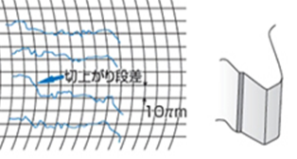
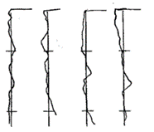
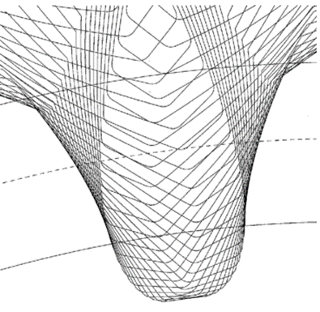
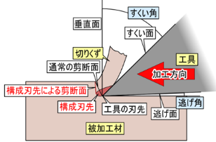
Machining troubleshooting
steep slope (incline)
If the cutter is swinging, the pitch accuracy of one workpiece revolution becomes discontinuous.
undulation of a tooth profile
Gears with small number of teeth, low meshing ratio, large load fluctuation
A cut and rise step occurs
The depth of cut changes, so the OBD varies.
The cutter work is shaken and becomes a tooth-shaped swell
The figure shows a spur gear.
With helical gears, steps are
Appears obliquely on the tooth surface
Reduce load and suppress load fluctuation
During the machining of one tooth, the number of cutting edges on each side involved in the machining process changes, causing the workpiece to swing from side to side, resulting in a wavy tooth profile.
A cut-off step occurs.
cause | counter-measure
Poor cutter mounting runout and equipment rotation accuracy Runout of product, poor cutter accuracy | Confirmation of cutter runout, arbor runout, and product runout accuracy, and confirmation of cutter pitch error
cause | counter-measure
Load fluctuation and clamping jig mismatch during machining Clamp pressure drop | Change of load reduction machining conditions and jig clamping width Change/Adjust clamp pressure
If the position of the cutting edge is shifted, the tooth profile accuracy becomes poor.
Tooth surface swelling caused by constitutive cutting edge
If the cutter and workpiece do not rotate smoothly, the positioning relationship will be misaligned and tooth profile accuracy will be reduced.
1. Cutting resistance change of bite
2. imbalance between left and right cutting edges
3. Rotation accuracy of master worm
counter-measure
1-Review of machining conditions (cutting speed, take-up)
2-tool coating
3 - Cutting oil with high activity
4-Work hardness and organization
Repeated generation and shedding of component cutting edges on the cutting edge of the cutter
cause | counter-measure
Improper grinding of cutter rake surface, improper installation of cutter, improper accuracy of guide | Check rake surface roughness, rake angle, and arbor runout Guide wear
cause | counter-measure
High cutting speed, Large clearance, Cutter material Cutter coating peeling, cutting oil | Review of processing conditions and coating Cutting oil change

Slide 7
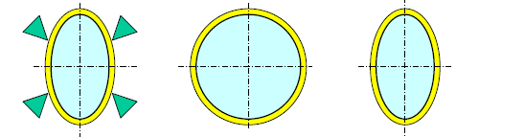
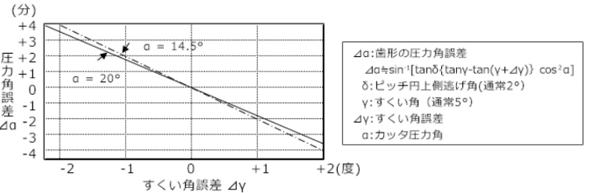
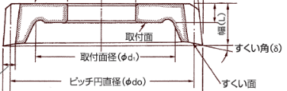
Problems during continuous machining
Change in tooth thickness
groove in the upper lip that runs from the bottom of the nose to the lip
Assessing the situation and looking for the real cause
Effect of pre-processing (thin-walled gears)
continuous
Changes over time
Periodic change
Varying sporadically.
thermal distortion
Cutter runout
chip infeed
Worked around and other
Clamped into an ellipse on the lathe in the previous process
Collet clamps to a perfect circle during gear cutting
It returns to the original shape when unclamped during measurement.
Coolant temperature control
flashing
rough skewer
Processing at a fixed position
How to apply coolant
Clamping force UP
Runout of tooth groove
Cutter runout and OBD changes
+, -, +, - makes two mountain swings.
Periodic change in OBD during continuous machining due to runout of the cutter
Effect of rake angle error of cutter
NO.2
NO.1
NO.3
NO.4
In general, when the number of teeth of a cutter is large, the finishing position of the cutter changes depending on the workpiece.
The cutter was swinging and the OBD is changing periodically.
OBD changes due to change in depth of cut
If there is an error in the rake angle of the pinion cutter
It becomes the pressure angle error of the tooth profile.
Runout of the cutter is improved.
When the cutter is started from the fixed position, the OBD is stable

Slide 8
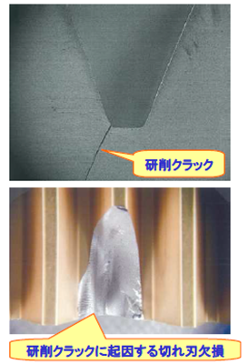
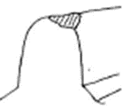
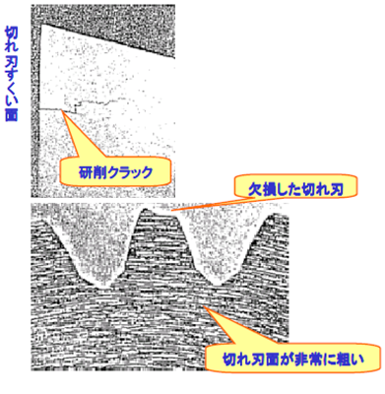
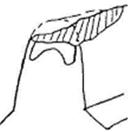
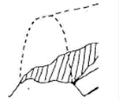
Cutting edges of pinion cutters
Loss of cutting edge of pinion cutter
Loss of cutting edge from cracks during grinding
figure | cause | counter-measure
 | Abnormal cutting vibration Unsuitable cutter material Cutter heat treatment failure Grinding Cracks | Review of processing conditions Increased mounting rigidity Cutter material review Measures against clogging of grinding wheel
 | thermal fissure Cutter heat treatment failure Grinding Cracks | Review of processing conditions Cutter material review Measures against clogging of grinding wheel
 | Machine operation failure reliving interference Grinding Cracks | Machine drive system inspection Review of machining conditions and offsets Measures against clogging of grinding wheel
Grinding Crack
Cutting Edge Rake Surface
Grinding Crack
Missed cutting edge
Cutting blade defect due to grinding crack
Cutting surface is very rough

Slide 9
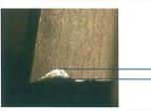

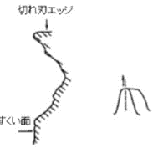
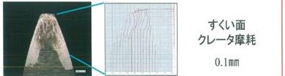
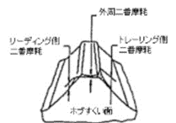
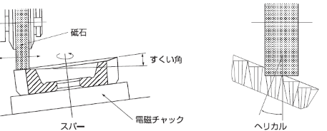
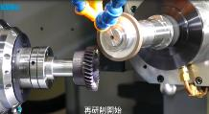
Resharpening of pinion cutters
Guidelines for resharpening
Cutter cutting conditions (reference)
Approximate amount of wear on the escape surface
0.15 to 0.2 mm
type | rough end | Grinding wheels
 |  | Types of grinding stones | Grindstone dimensions D x T x H | Grinding wheel peripheral speed m/min | Depth of cut of abrasive stone (mm)1 time | Grinding feed speed | courante | Grinding surface roughness μm | Blade grinding machine (Reference)
spar type | rough | PA46H8V | 230X16X40 | 1860 | 0.02,0.01 | 55rpm | Chemical Solution Type | 0.4 to 0.6 | YUNO GF-12 ROTALY GRINDER
 |  | CB80T | 200X16X51 | 1200-1500 | 0.05 to 0.06
 | end | PA48H8V | 230B16X40 | 1860 | 0.003 | 55rpm
 |  | GC100H | 225X19X51 | 1080-1200 | 0.002 to 0.003
helical type | rough | PA8018W | 125X16X32 | 1400-1700 | 0.03 to 0.05 | 10-14 m/min |  | 0.8 to 1.2 | MICO COLLET A020D
 |  | or
 |  | 38A60I8V | 150X16X32
 |  | PA8018V | 250X16X76.2 | 2040 | 0.03 | 10.5 m/min
 |  | or
 |  | 38A60I8V
 | end | PA80I8V | 125X16X32 | 1400-1700 | 0 to 0.01 | 10-14 m/min
 |  | or
 |  | 38A60I8V | 150X16X32
 |  | PA80K8V | 250X16X76.2 | 2040 | 0 to 0.02 | 10.5 m/min
 |  | or
 |  | 38A80K8V
Re-grinding allowance = amount of wear + about 0.1 to 0.2 mm
Tooth width used = about 1/2 to 2/3 of the total tooth width
Wear residue leads to abnormal wear.
Rake surface Crater wear
0.1mm
Phenomenon of trouble | cause | counter-measure
steep slope (incline) | 1. cutter installation failure 2. cutter spindle rotation accuracy and table rotation speed failure 3. poor installation of machined gears 4. inaccuracy of cutter | Check the runout of the cutter and arbor. Machine Accuracy Survey Check the runout of the workpiece gear. Confirmation of runout and pitch error of cutter tooth groove
Pitch error failure Poor runout of tooth groove Defective tooth profile error | 1. cutter rake surface grinding failure 2. defective installation of cutter 3. guide inaccuracy 4. poor cutter spindle rotation accuracy and table rotation accuracy 5. Pre-processing failure of machined gears | Checking the runout, surface roughness and rake angle of the cutter rake face Check the runout of the cutter and arbor Guide wear check Backlash and accuracy survey of master worm and wheel, accuracy survey of change G Confirmation of workpiece gear inner diameter and end face runout
Poor tooth surface roughness | 1. cutter rake surface grinding failure 2. poor machining conditions 3. component blade edge adhesion 4. unsuitable depth of cut 5. lack of workpiece shape and mounting rigidity 6. drive train rattle | Checking the runout, surface roughness and rake angle of the cutter rake face Review of processing conditions Please check the selection of cutting fluid and how to apply it Review processing conditions Review of mounting jigs Check the machine
Cutter life | 1. large number of strokes 2. machine rigidity and vibration 3. unsuitable cutter design | Review of processing conditions Machine Survey Request to manufacturer for review
limit of resuscitation
Depending on the specifications, the tooth base diameter and chamfering diameter may be out of tolerance, which may determine the width of the tooth to be used.
Limit line indication on the side of the cutter
Correct edging is important.
However, eccentricity of the edging conical surface causes runout of the cutter, and rake angle error causes pressure angle error.
The surface roughness of the cutting edge of the pinion cutter is within 3.2Ry according to JIS, but making the surface roughness as good as possible will extend the service life, and the cutting surface can be finished well with less swelling.
Tooth profile accuracy, runout, roughness of the flank surface, and grinding burn affect tooth profile accuracy, cutting edge step, tool life, and cutting edge loss.
Rough rake surface reduces tool life
3.3μ
Blade surface roughness
0.6μ

